Slide 1

Canadian Economy Roundtable
Join us next Thursday October 1st at 10am EST for a round table discussion on Thriving in the New Canadian Economy.
We’ll be discussing several of the strategies from our discussion with Peter Hall, sharing best practices and strategies to ensure the long-term resilience of manufacturing in Canada.
This will be a facilitated discussion, and is open to senior manufacturing leaders.
Watch your email for further details, and to register!
Next Generation Manufacturing Canada

Slide 2




Covid-19 & resilience in Canadian manufacturing
NGen Thought Leader Series – September 24, 2020
Peter Hall, Vice President and Chief Economist
@PeterGHallXIII
Peter Hall
Economic Insights

Slide 3

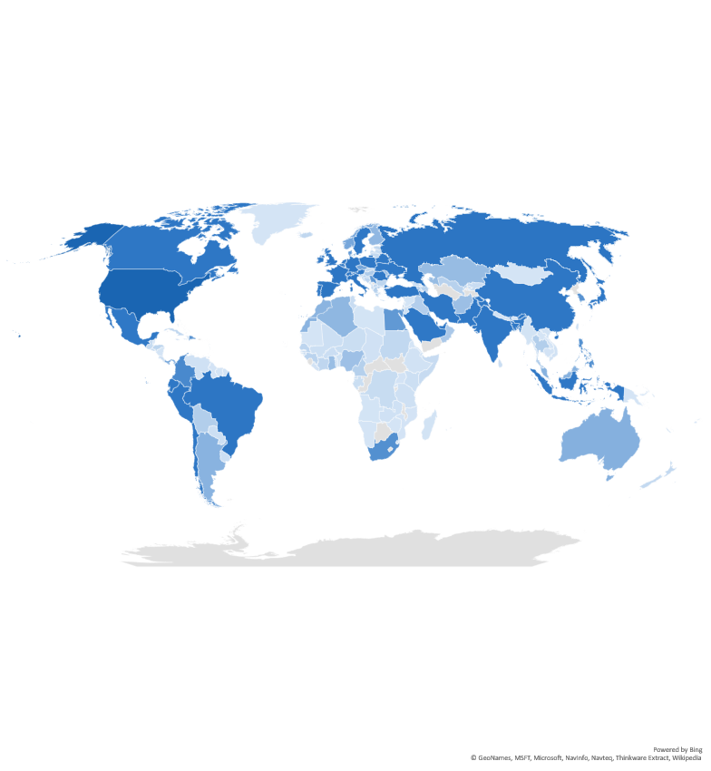
Confirmed COVID-19 cases
As of September 14, 2020
29 million
World total
Canada
139k
UK
371k
Russia
1.1m
U.S.
6.5m
Spain
566k
Italy
289k
China
90k
Mexico
668k
India
4.8m
Peru
729k
Brazil
4.3m
South Africa
649k
Sources: EDC Economics; John’s Hopkins Coronavirus Research Center.

Slide 4
Retail sales: looks like a “v”!
Canada
U.S.
Euro Area
Sources: Haver Analytics, EDC Economics

Slide 5
Pent-up demand: savings explosion
Canada
U.S.
Euro Area
Sources: Haver Analytics, EDC Economics

Slide 6
Goods exports: another v-shaped recovery!
Canada
Euro Area
U.S.
Sources: Haver Analytics, EDC Economics

Slide 7
Not so for services exports: the dreaded “l”
Euro Area
Canada
U.S.
Sources: Haver Analytics, EDC Economics

Slide 8
Wide array of responses by industry
Goods exports, Canada, index values; Nov 2019 = 100
Sources: Haver Analytics, Statistics Canada, EDC Economics

Slide 9
Gdp: the plunge and the journey back
← extent of decline
extent of recovery →
Sources: Haver Analytics, EDC Economics

Slide 10
Confidence
Canadian confidence for businesses has rebounded towards more normal levels, while consumers remain cautious.
Business and consumer confidence indices (monthly)
Consumer
Canadian jobs in “high-COVID-risk” sectors
Notes: 50+ = positive consumer sentiment. Consumer sentiment is weekly, aggregated monthly using last value. June value corresponds to the first week of June.
Sources: Nanos Canadian consumer sentiment index, CFIB business barometer

Slide 11
TCI: Canadian exporters’ overall investment plans became more optimistic.
Plan to increase investment*, percentage of respondents
Mid-Year 2020: 31%
*If the Canadian dollar stays around its current level for the next two years.
Notes:
Compare time series to BoC
https://www.bankofcanada.ca/2019/10/business-outlook-survey-autumn-2019/#chart3
Note that BoC BOS data is quarterly, I’m taking just Q2 and Q4 data. The BOS question is slightly different:
Over the next 12 months, your firm’s investment spending on M&E (compared with the past 12 months) is expected to be higher (% of respondents)
ST: We can cut the BOS, the labour question on the next slide is much more directly comparable. .

Slide 12
TCI: Canadian exporters expect financing conditions to worsen.
Terms and conditions for obtaining financing in the next six months, percentage of respondents
Mid-Year 2020: 44%

Slide 13







TCI top challenge: Global economic conditions are the
Challenges contemplating, growing on maintaining business outside of Canada
What challenges are your company experiencing while contemplating,
growing or maintaining business outside of Canada?
(Percentage of respondents)
40%
32%
30%
27%
26%
Global economic conditions
Maintaining cash flow
Connecting with customers
Access to capital
Identifying
potential customers

Slide 14
FINANCIAL MARKETS
Equity markets have largely recovered or surpassed their pre-COVID levels; while bond spreads are slowly improving, but remain somewhat elevated.
Global Stock Markets
% change since Jan. 1
Global Debt Markets
%
Sources: Haver Analytics, EDC Economics; EDC Global Financial Markets.

Slide 15
Commodity prices
Global Economic Outlook | 2019 | 2020* | 2021*
Brent Crude Spot, USD / bbl | 64.36 | 42.80 | 43.95
West Texas Intermediate, USD / bbl | 56.99 | 38.65 | 41.13
Western Canada Select, USD / bbl | 43.30 | 27.76 | 31.76
Natural Gas, USD / MMBtu | 2.55 | 1.84 | 2.12
Gold, USD / troy ounce | 1,392 | 1,806 | 1,920
Copper, USD / tonne | 6,002 | 5,924 | 5,989
Note: * denotes the forecast period.
Source: EDC Global Economic Outlook, September 2020

Slide 16
currencies and interest rates
Global Economic Outlook |  | 2019 | 2020* | 2021*
Currency | Exchange Rate
U.S. dollar | USD per CAD | 0.75 | 0.74 | 0.76
Euro | CAD per EUR | 1.49 | 1.52 | 1.56
Euro | USD per EUR | 1.12 | 1.13 | 1.18
Interest Rates, annual average
Bank of Canada, Overnight Target Rate |  | 1.75 | 0.56 | 0.25
U.S. Federal Reserve, Fed Funds Target Rate (Upper limit) |  | 2.14 | 0.39 | 0.10
European Central Bank, Policy Interest Rate |  | 0.00 | 0.00 | 0.00
Note: * denotes the forecast period.
Source: EDC Global Economic Outlook, September 2020

Slide 17
A normal post-gfc year…
Global Economic Outlook (GDP, annual % change) | 2019
Developed countries | 1.7
Canada | 1.7
United States | 2.2
Eurozone | 1.3
Germany | 0.6
France | 1.5
Japan | 0.7
Emerging countries | 3.7
China | 6.1
India | 4.2
Brazil | 1.1
Mexico | -0.3
Total World | 2.9
Note: * denotes the forecast period.
Source: EDC Global Economic Outlook, September 2020

Slide 18
…followed by disaster
Global Economic Outlook (GDP, annual % change) | 2019 | 2020*
Developed countries | 1.7 | -5.5
Canada | 1.7 | -5.8
United States | 2.2 | -3.4
Eurozone | 1.3 | -7.6
Germany | 0.6 | -5.6
France | 1.5 | -9.6
Japan | 0.7 | -5.6
Emerging countries | 3.7 | -3.6
China | 6.1 | 1.7
India | 4.2 | -11.7
Brazil | 1.1 | -6.5
Mexico | -0.3 | -10.0
Total World | 2.9 | -4.3
Note: * denotes the forecast period.
Source: EDC Global Economic Outlook, September 2020

Slide 19
…and then the rebound
Global Economic Outlook (GDP, annual % change) | 2019 | 2020* | 2021*
Developed countries | 1.7 | -5.5 | 5.7
Canada | 1.7 | -5.8 | 5.7
United States | 2.2 | -3.4 | 4.9
Eurozone | 1.3 | -7.6 | 7.0
Germany | 0.6 | -5.6 | 6.3
France | 1.5 | -9.6 | 8.9
Japan | 0.7 | -5.6 | 4.6
Emerging countries | 3.7 | -3.6 | 7.0
China | 6.1 | 1.7 | 9.0
India | 4.2 | -11.7 | 16.1
Brazil | 1.1 | -6.5 | 4.0
Mexico | -0.3 | -10.0 | 5.9
Total World | 2.9 | -4.3 | 6.6
Note: * denotes the forecast period.
Source: EDC Global Economic Outlook, September 2020

Slide 20





Key takeaways
Recovery: uneven
Pandemic: different ways of working
Re-shoring, near-shoring, glocalization: trade transformation
More virtual activity, mechanization
Costs, capacity, behaviour: how much change?

Slide 21

Edc economics free resources
Sign up now for EDC’s Economic Insights newsletter. Get key insights on:
  Country Risk Quarterly
  Global Export Forecast
  Weekly Commentary
  Trade Confidence Index
  The Commodity Tracker
  Research reports on international trade
  Tracking Canada’s economic recovery
SIGN UP HERE
@PeterGHallXIII
Peter Hall
Economic Insights
Notes:
Overview

Slide 22
QUESTIONS & discussion

Slide 23



Slide 24
What’s Next Thought Leadership → October 22nd
Join us Thursday October 22nd at 11am EST for our next What’s Next Through Leadership series event.
Topic: Situation Evolving: Adaptability Key to Survive and Thrive in a Second Wave
We’ll be joined by the BC Safety Alliance to discuss strategies to thrive amidst a second or third pandemic wave.
Watch your email for further details, and to register!
Next Generation Manufacturing Canada

Slide 25
Global merchandise trade
While global merchandise trade was hit hard during shutdowns in March through May, early indications suggest that a rebound began in June.
Global merchandise trade volumes
annual % change
WTO forecast for goods trade expects a 13% drop in 2020.
Sources: CPB Netherlands Bureau for Economic Policy Analysis, WTO April 2020 Trade Forecast
Notes:
Updated to include Dec 2019

Slide 26
Canada’s Labour market
Services sector employment, which held up reasonably well in past Canadian recessions,
has been hit particularly hard, in areas such as restaurants, retail and recreation.
Goods and services employment
year-over-year % change
Employment Changes, by Sector
August 2019 to August 2020, Thousands
In GDP at risk
Sources: Haver Analytics, EDC Economics

Slide 27
Alberta exports: trouble with #1
← depth of decline
extent of recovery →
Sources: Haver Analytics, EDC Economics

Slide 28
Gasoline Stock gradually returns to trend
Stocks of US Gasoline - 2020 Compared to 5yr Range
US weekly oil production (mn/bbls)
Sources: EDC Economics, Haver Analytics, Energy Information Administration

Slide 29
Changes from previous forecast
Global Economic Outlook Real GDP Growth (percentage point change) | 2020* | 2021*
Developed countries | -0.1 | -0.4
Canada | 3.2 | -1.5
United States | 1.7 | -2.0
Eurozone | -1.3 | 0.5
Germany | -0.7 | 0.4
France | -1.4 | 0.6
Japan | -1.5 | 0.5
Emerging countries | - | -0.3
China | 3.3 | -1.0
India | -8.1 | 5.0
Brazil | 0.6 | -0.2
Mexico | -2.1 | 1.1
Total World | - | -0.3
Note: * denotes the forecast period.
Source: EDC Global Economic Outlook, September 2020 relative to June 2020.

Slide 30
2020 forecast Comparison
Global Economic Outlook (GDP, annual % change) | EDC | OECD
Developed countries | -5.5
Canada | -5.8 | -5.8
United States | -3.4 | -3.8
Eurozone | -7.6 | -7.9
Germany | -5.6 | -5.4
France | -9.6 | -9.5
Japan | -5.6 | -5.8
Emerging countries | -3.6
China | 1.7 | 1.8
India | -11.7 | -10.2
Brazil | -6.5 | -6.5
Mexico | -10.0 | -10.2
Total World | -4.3 | -4.5
Note: * denotes the forecast period.
Sources: EDC Global Economic Outlook, September 2020; OECD

Slide 31
2021 forecast Comparison
Global Economic Outlook (GDP, annual % change) | EDC | OECD
Developed countries | 5.7
Canada | 5.7 | 4.0
United States | 4.9 | 4.0
Eurozone | 7.0 | 5.1
Germany | 6.3 | 4.6
France | 8.9 | 5.8
Japan | 4.6 | 1.5
Emerging countries | 7.0
China | 9.0 | 8.0
India | 16.1 | 10.7
Brazil | 4.0 | 3.6
Mexico | 5.9 | 3.0
Total World | 6.6 | 5.0
Note: * denotes the forecast period.
Sources: EDC Global Economic Outlook, September 2020; OECD

